Slide 1
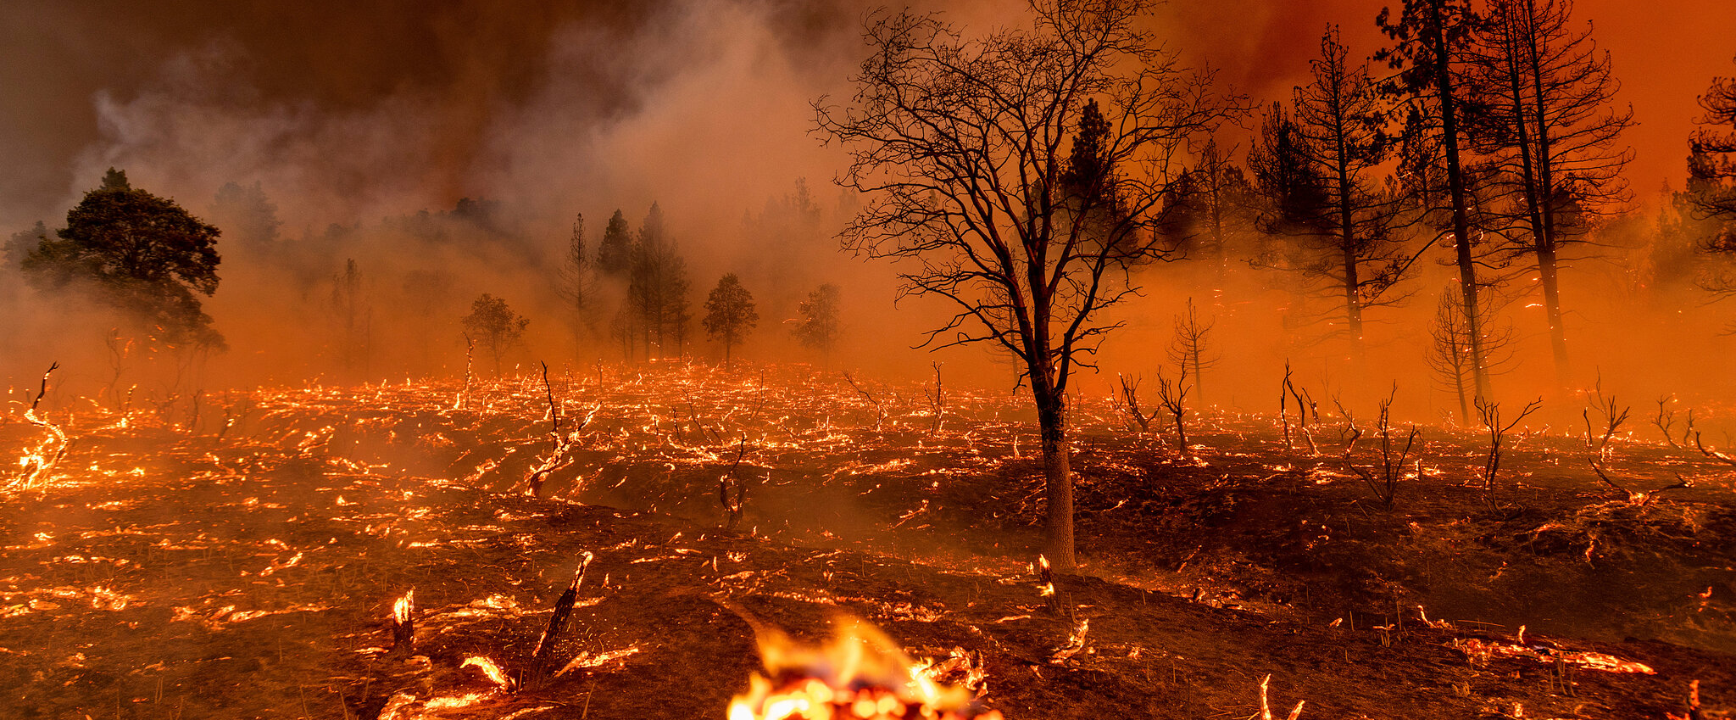

Deep Learning
SCS 3546
Forest fire monitoring using Deep Neural Network
Presenter: Sigao Li
Instructors:
Prof. Sina Jamshidi
Prof. Simon Tavasoli
December 5th, 2023

Slide 2

Introduction to the Project
Background:
In recent years, due to climate change and other environmental factors, the frequency of forest fires has significantly increased. Timely detection of forest fires in the early stages is crucial for controlling the spread.
Currently, the use of satellite remote sensing images for forest fire detection has become a popular monitoring method. However, due to limitations in resolution and timeliness, there is still room for technological advancement in this field.
Objectives:
The goal of the project is to develop a machine learning model capable of identifying areas at risk for forest fires using satellite imagery. Focuses on using image processing and deep learning techniques to accurately and efficiently detect forest fires.
Note: Adapted from “NASA’s SAGE III Instrument Observes Aerosol Spike from Australian Fires”
Extreme fire activity was seen above Australia from the International Space Station in January 2020

Slide 3
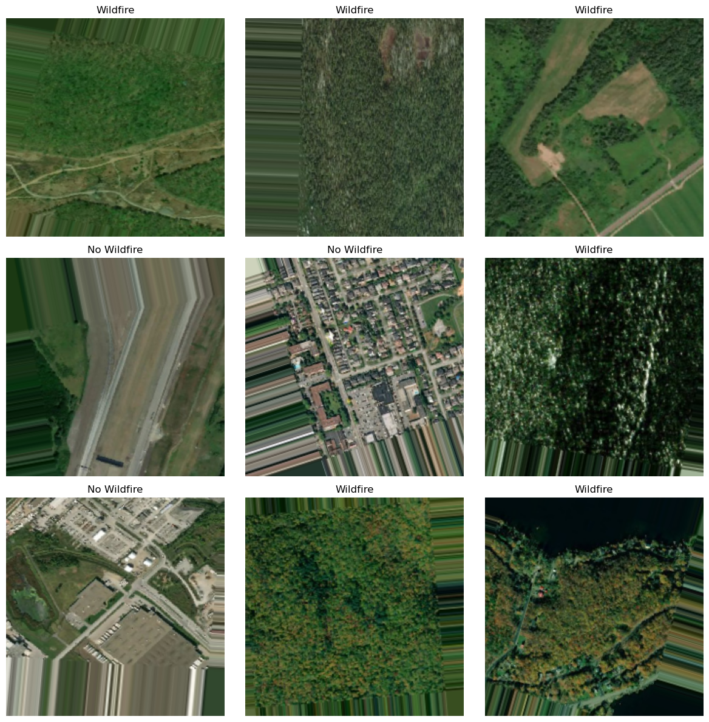
Data Overview and Preprocessing
Data Source:
The original data set comes from the Government of Canada-"Forest fires" and was compiled by ABDELGHANI AABA and uploaded to Kaggle.
Each image is extracted from satellite imagery of forest fire sites using longitude and latitude coordinates, and the image resolution is 350x350 pixels.
Data Preprocessing:
1. Corrupted images are identified and deleted.
2. Balance the data set.
Train: #14000=70%
Test: #3000=15%
Validation: #3000=15%
3. Apply data enhancement techniques such as: random rotations, shifts, zooms, and flips to enhance the generalization ability of the model.

Slide 4
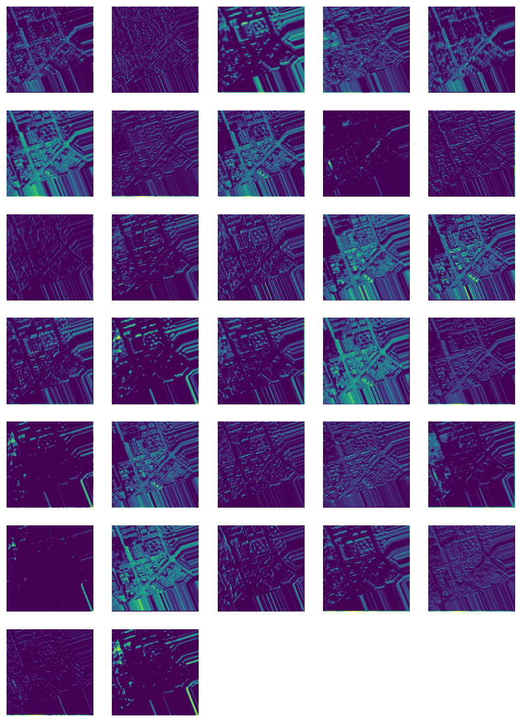
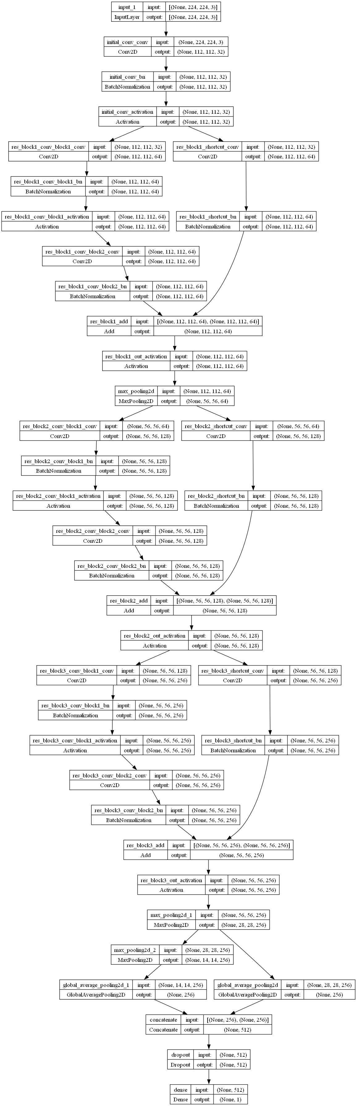
Model Architecture and Training
Key Features
01
Convolutional Neural Network (CNN)
Residual Block (3)
MaxPooling
Batch Normalization
Dropout Layers (0.5)
Training Process
02
Binary cross-entropy loss function
Adam optimizer
30 epochs & 32 batch size
Early Stopping (5 epochs)
Feature Maps Visualization

Slide 5
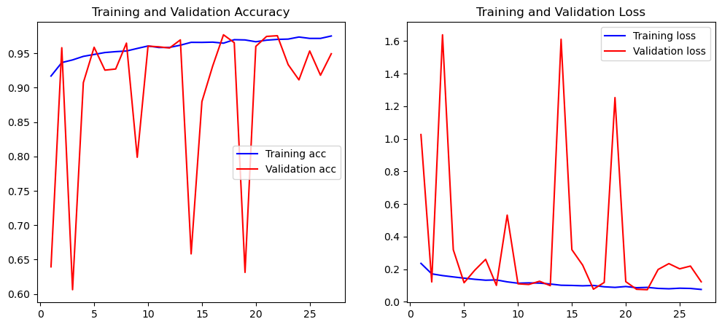
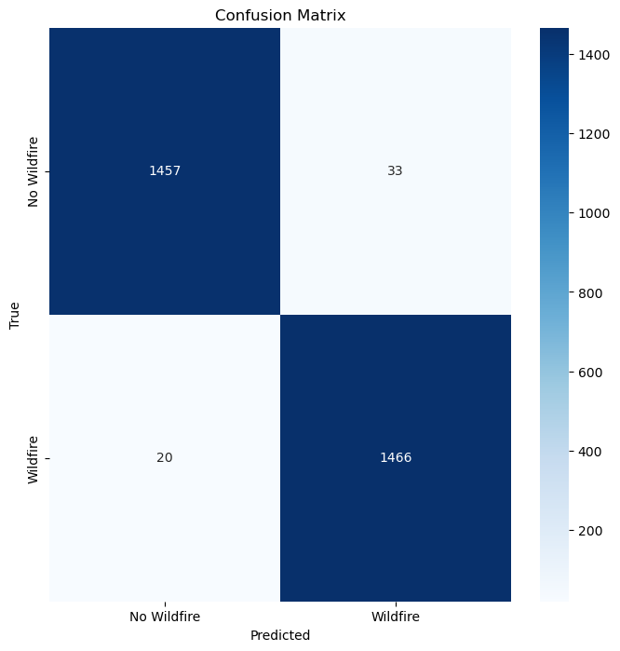
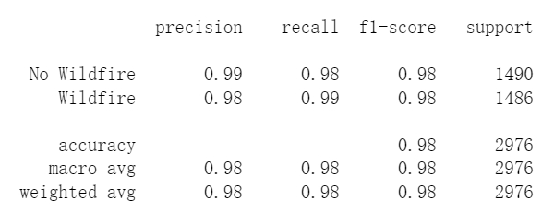
Results and Performance Evaluation
The model achieved an accuracy of 97.51% on the train set and 94.93% on the validation set.
Upon evaluation on unseen test data, the model demonstrated a high accuracy of 98.25% and a loss of 0.0582.

Slide 6
Conclusions and Future Work
Conclusions:
This project develops a convolutional neural network model capable of detecting forest fires from satellite imagery. The model demonstrates robustness, showing high accuracy and low loss on validation and test data.
This work contributes to the field of environmental monitoring and demonstrates the potential of artificial intelligence in aiding disaster management and response initiatives.
填写标题
您的内容打在这里，或者通过复制您的文本后，在此框中选择粘贴，并选择只保留文字。您的内容打在这里，或者通过复制您的文本后，在此框中选择粘贴，并选择只保留文字。
Future Work:
The integration of other data sources, such as combining temperature, wind pattern or radar image data, can be explored in the future to further improve the accuracy of the model.
Further research may involve exploring other deep learning methods such as Transformers, or trying to use unsupervised learning techniques for feature extraction.

Slide 7
THANKS
FOR WATCHING
Presenter: Sigao Li
Instructors:
Prof. Sina Jamshidi
Prof. Simon Tavasoli
December 5th, 2023

